Slide 1
PowerPoint Accessibility Training
“Design with accessibility in mind.”

Slide 2
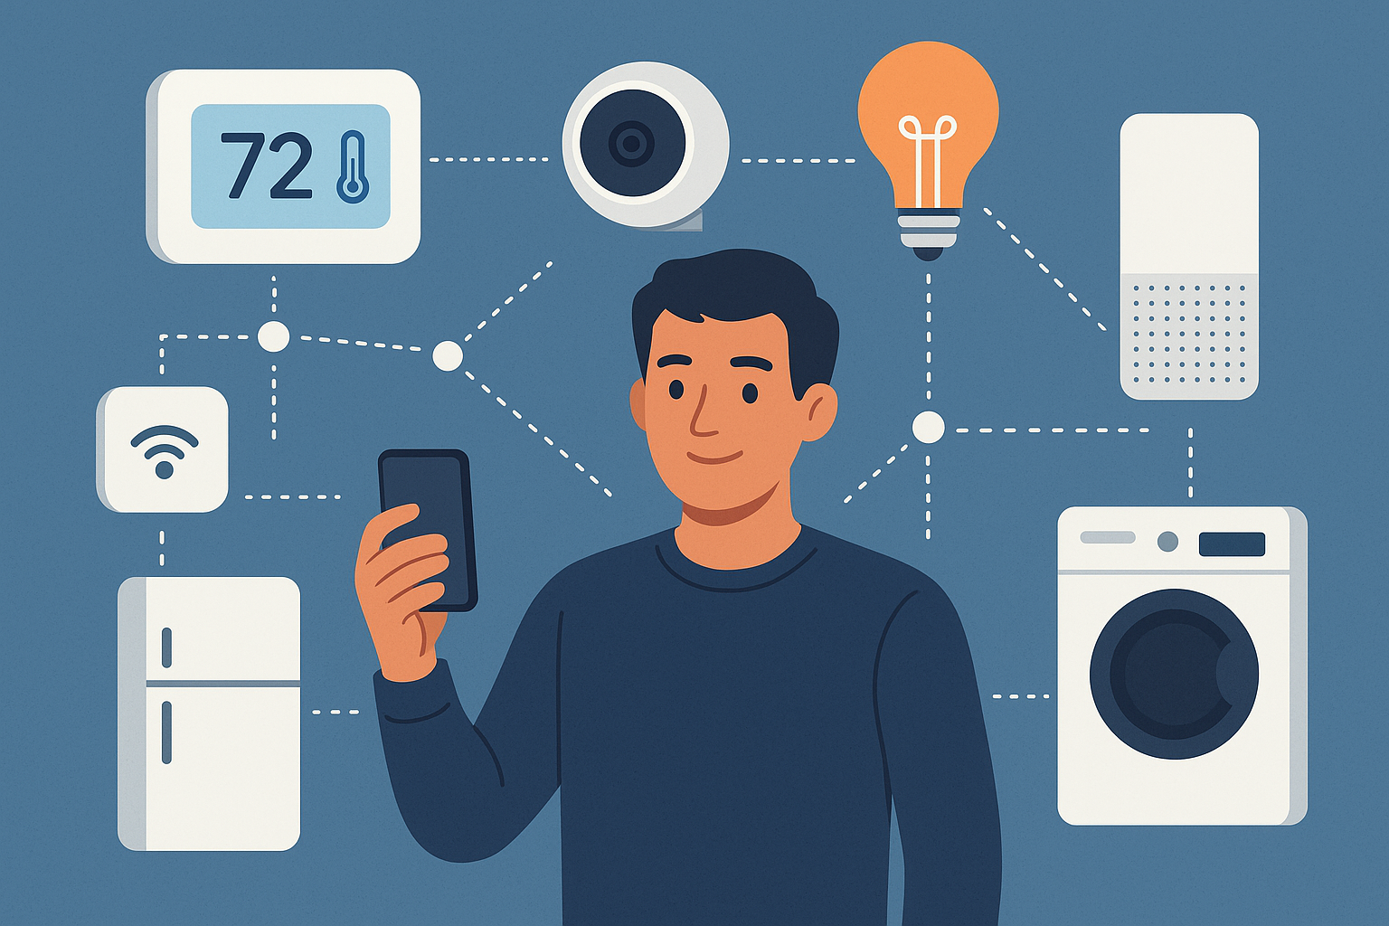
Verify Slide Reading Order

Slide 3
Verify Slide Reading Order
When most people generally think about using the internet, they think about computers and their phones. But actually, these aren’t the only devices that use the internet anymore. It’s common now for many households to have many internet connected devices such as televisions, gaming consoles, security alarms, security cameras, alarm clocks, lights, watches, refrigerators, microwaves and washing machines. Essentially having all these connected devices has caused people to start to talk about the internet of things.
At the moment, not every household has every appliance connected to the internet, but over the next decade, internet connected items will be even more common. Internet connected devices are very helpful to humans because they can help to automate and assist with many parts of an individual’s daily life.
A person with a fully internet connected home could have quite a bit of their day planned by the various machines they own.
One could wake up in the morning, have their alarm tell them the weather, the daily news and check their calendar for appointments that day. While having breakfast, the refrigerator notices that there won’t be enough milk in two day’s time and orders a new bottle online so there will always be some available to drink in the morning. Then as a person is leaving their home and going to work, their car can check the daily traffic report and adjust the journey. Even better, on days when traffic is significantly heavy, a smart alarm clock could see that traffic is heavy and wake up someone a little earlier so they won’t be late to work, letting them know what’s going on so they won’t be late. It’s events like these that seem to be where the world of the internet is heading at the moment and much of it can be quite handy.
Source: https://ipstarbroadband.com.au/what-is-the-internet-of-things-iot-and-is-it-the-future/

Slide 4
Questions?
To learn more, Click here.
Other useful resources:
  https://www.ibm.com/think/topics/internet-of-things
  https://www.oracle.com/internet-of-things/

Slide 5
Important Note
The final exam on the Internet of Things module will be available on Canvas starting October 21 at 12:00 a.m. and will close on October 28 at 11:59 p.m. Please make sure to complete your exam before the deadline. Any exceptions will be granted at the instructor’s discretion.

Slide 6


